Slide 1
Lecture 3
The Definition of Conditional Probability.
Independent Events.

Slide 2
Problem:
Suppose that in the general population, the probability of purchasing commercial health insurance is 10%.
Consider people who are 25~34 years old. Would the probability of purchasing commercial health insurance still be equal to 10%?

Slide 3

2.1 Definition of Conditional Probability
The probability of an event A changes after it has been learned that some other event B has occured. This new probability of A is called the conditional probability of the event A given that the event B has occured. It is denoted by
Notes:
若天空出现乌云，下雨的概率增加
与普通一天相比，节日里购物者的比例更大，商家销售更多
国际原油价下跌，国内汽油涨幅超过1元的概率变小

Slide 4
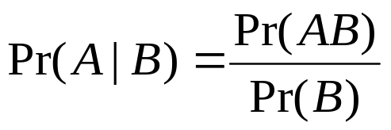
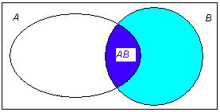
Definition: if Pr(B)>0,
It is the proportion of Pr(B) that is represented by Pr(AB).
If Pr(B)=0, Pr(A|B) is not defined.

Slide 5
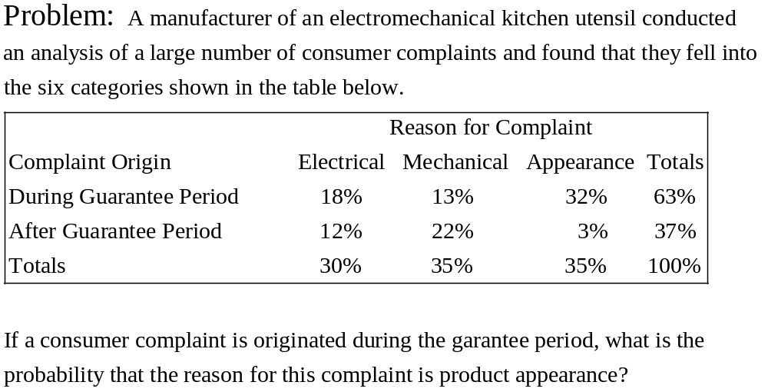

Slide 6
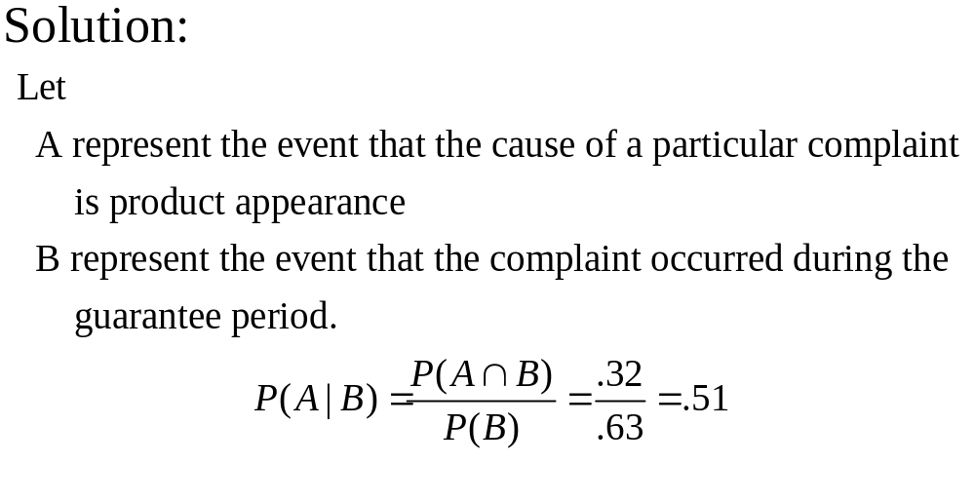

Slide 7
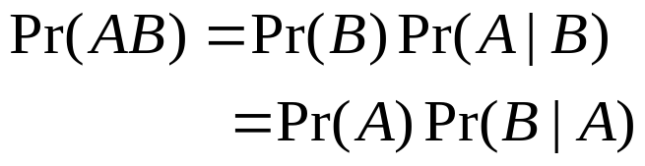
Multiplication Rule for
Conditional Probabilities

Slide 8
Example: Investing in Wheat Futures
An investor in wheat futures is concerned with the following events:
  A: {Chinese production of wheat will be profitable next year}
  B: {A serious drought will occur next year}
  Based on available information, the investor believes that the
  probability is .01 that production of wheat will be profitable
  assuming a serious drought will occur in the same year and
  that the probability is .05 that a serious drought will occur.
  What is the probability that a serious drought will occur and
  that a profit will be made?

Slide 9
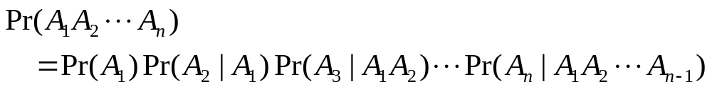
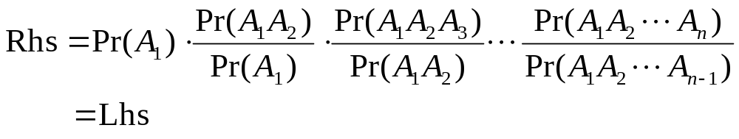
Theorem 2.1.1 Suppose that A1,...,An are any events such that Pr(A1A2...An-1)>0. Then,
Proof.

Slide 10
Example: Selecting Four People
Four people are to be selected, without replacement, from a room with m men and w women for a psychological test. What is the probability that the sequence of people will be man, woman, man, woman?

Slide 11
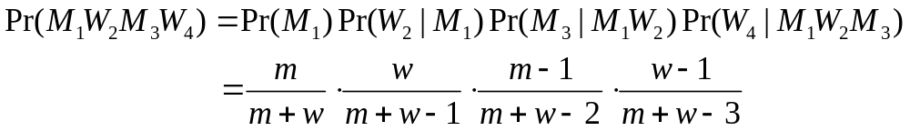
Solution
Let Mj denote the event that a man is selected for the jth spot, and let Wj denote the event that a woman is selected for the jth spot (j=1,2,3,4). Then

Slide 12
2.2 Independent Events
From the previous examples, we showed that the probability of an event A may be substantially altered by the knowledge that an event B has occurred.
However, this will not always be the case. In some instances, the assumption that event B has occurred will not alter the probability of event A at all.
When this is true, we say that the two events A and B are independent events.

Slide 13
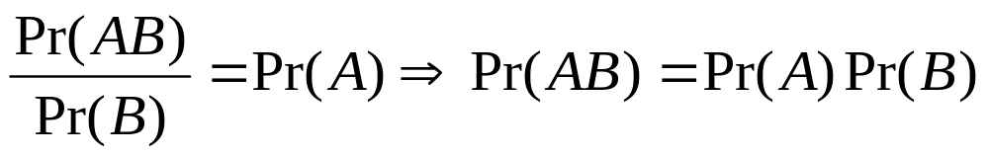
Indepedent Events
If learning that B has occurred does not change the probability of A, then we say that A and B are independent.
  If Pr(B)>0, the equation Pr(A|B)=Pr(A) can be rewritten as
Mathematical definition of independence: two events are independent if Pr(AB)=Pr(A)Pr(B).

Slide 14
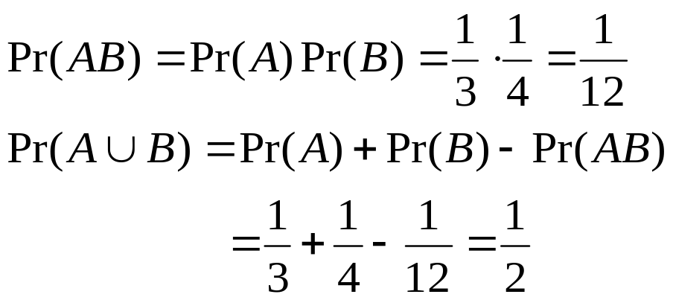
Example: Machine Operation
Machine 1 and machine 2 are operated independently of each other. A is the event that machine 1 will become inoperative in a given 8-hour period, and B is the event that machine 2 will become inoperative during the same period. Suppose that Pr(A)=1/3, Pr(B)=1/4. What is the probability that at least one of the machines will become inoperative during the given period?

Slide 15

A
B
S

Slide 16
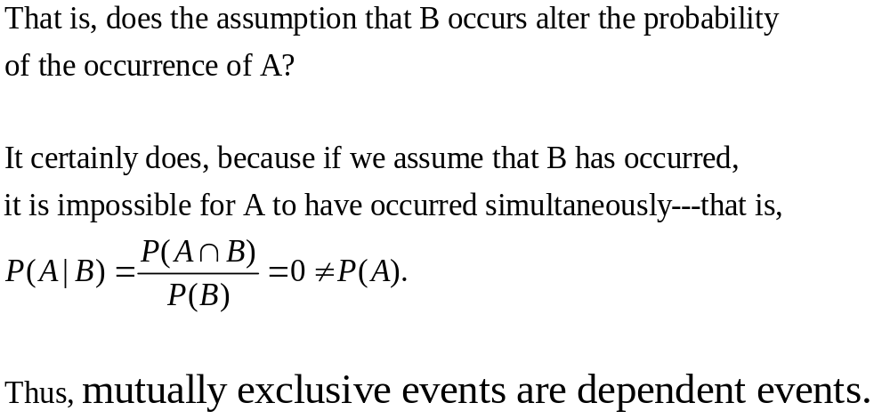

Slide 17




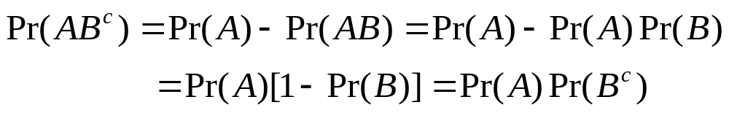



Theorem 2.2.1 If two events and are independent, then the events and
are also independent.
Proof.
Remark. Similarly, it can be shown that
and are indepedent, and that
and are also indepedent.

Slide 18



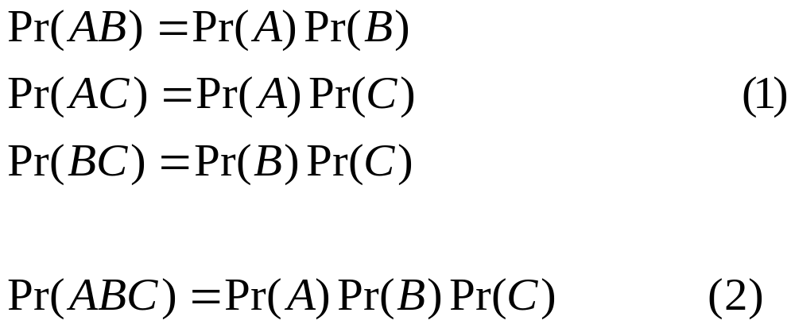

Independence of Several Events
The k events are independent if, for every subset of j of these events (j=2,3,...,k),
E.g. Two conditions must be satisfied in order for three events A, B and C to be independent.

Slide 19
Example 2.2.3 Pairwise Independence
An experiment has four outcomes {s1,s2,s3,s4}, and the probability for each outcome is 1/4.
A={s1,s2}, B={s1,s3}, C={s1,s4}
Then AB=AC=BC=ABC={s1}.
Pr(A)=Pr(B)=Pr(C)=1/2 and
Pr(AB)=Pr(AC)=Pr(BC)=Pr(ABC)=1/4.
(1) is satisfied, but (2) is not satisfied. So all three events are not independent.

Slide 20
Example 2.2.4 Inspecting Items
A machine produces a defective item with probability p (0<p<1) and a nondefective item with probability q=1-p. Suppose 6 items are selected at random and inspected, and that the outcomes for these 6 items are independent. What is the probability that exactly 2 of the 6 items are defective?

Slide 21
  Assume the sample space S contains all possible arrangements of 6 items, each one being either defective or nondefective.
  Let Dj denote the event that the jth item in the sample is defective, and let Nj denote the event that the jth item in the sample is nondefective.
Notes:
List several sequences with 6 items, 2 being defective.

Slide 22

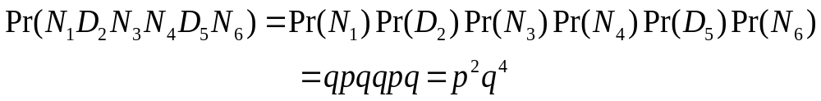

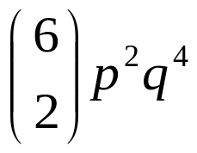
  The probability of each particular sequence in S containing 2 defective items and 4 nondefective items is . E.g.
  The number of such sequences is
  So the probability of obtaining exactly 2 defectives is

